Slide 1
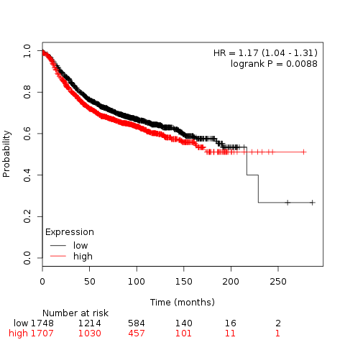
1.0
0.8 0.6 0.4 0.2 0.0
HR =1.17 (1.04 - 1.31)
logrank P = 0.0088
RFS probability
low
high
0 50 100 150 200 250
Time (months)

